Slide 1
Doctoral Dissertation Proposal: Generic Framework for Prioritizing Content of Interest in Multimedia Data Compression
Chong Shao
Notes:
XXX details about H.264: how it handles the region of interest ?????
XXX may add a backup slide for sliding window
Xxx read the nature paper
Xxx read the microscopy paper
Planned edit: add quality metric design result if I can have it
add navy data result
find out if there is a link between “efficient regression” in video decomposition and http://ieeexplore.ieee.org/xpl/articleDetails.jsp?arnumber=6803938, if no, remove that slide
http://radar.oreilly.com/2014/03/battery-technology-is-not-keeping-pace-with-computing-power-demands.html
http://wikiblinks.com/1-feature-the-iphone-desperately-needs-battery-life/
https://www.statista.com/chart/3780/tv-screen-size/
http://drpeering.net/white-papers/Internet-Transit-Pricing-Historical-And-Projected.php
http://blog.dshr.org/2016/05/talk-at-seagate.html
http://blog.dshr.org/2014/03/the-half-empty-archive.html
http://ieeexplore.ieee.org/xpl/login.jsp?tp=&arnumber=6269460&url=http%3A%2F%2Fieeexplore.ieee.org%2Fxpls%2Fabs_all.jsp%3Farnumber%3D6269460
http://dl.acm.org/citation.cfm?id=290814
http://ieeexplore.ieee.org/xpl/login.jsp?tp=&arnumber=4387595&url=http%3A%2F%2Fieeexplore.ieee.org%2Fxpls%2Fabs_all.jsp%3Farnumber%3D4387595

Slide 2
Multimedia System
Data Acquisition
Storage/Transmission
Data Consumption
Notes:
We can consider Data flow in multimedia system has three stages
I will show three examples of multimedia system

Slide 3


Example1: microscopy video
Data Acquisition
Storage/Transmission
Data Consumption
Notes:
The first example
The upper left shows a high throughput … ~1TB / hour
For this system, the microscopy takes the data, store it in disk, and the data consumption is a analysis program that tracks the moving cells, and derive statisics based
On the tracking result
Scientists needs to store the video so that they can run analysis again later

Slide 4
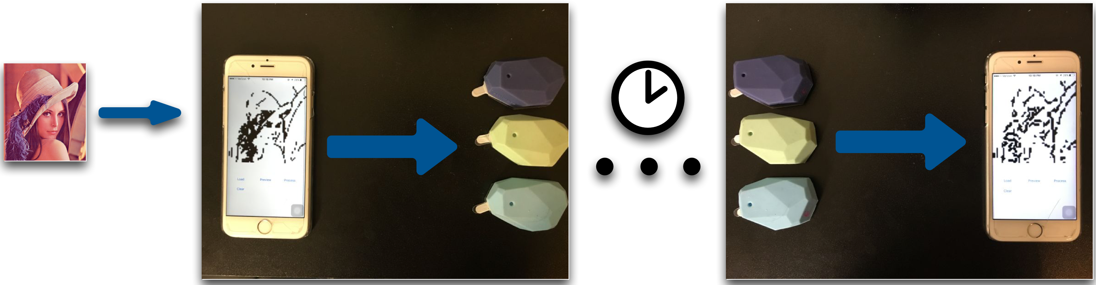
Example 2: BLE beacon based image data storage system
Data Acquisition
Storage/Transmission
Data Consumption
Writer
App
BLE
Beacons
Reader
App
Notes:
A second example is a image storage/retrivial system that uses Bluetooth beacons as storage device
This system allows user to write arbitrary image into a set of bluetooth beacon devices and later another user can read the image from the set of beacons
For this system, the data acuisistion componenet is the writer app running on the smartphoe….

Slide 5
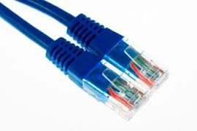
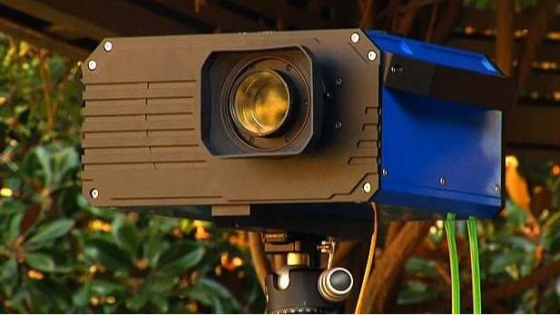
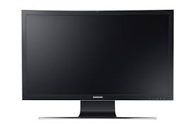
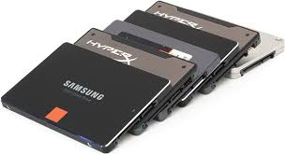
Example 3: gigapixel camera viewing system
Data Acquisition
Storage/Transmission
Data Consumption
Notes:
A third example is a gigapixel camera system paired with a standard display,, it self generates high resolution image or video,
Array of cameras: - stitch frames together to make larger ones - provide features including pan/tilt/zoom
There are various design choices
One is to divide the high resolution video stream
Into several fixed size smaller streams (tiles). The viewer
Only receives the tiles included by the current Region of Interest

Slide 6
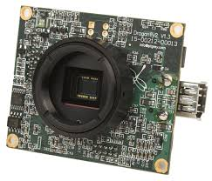

People are using existing software/hardware in building a new system.
Notes:
We can observe that in building these systems people are using existing software/hardware, Such as
Microscope uses a common industrial camera,
People are using BLE devices that are designed to boradcast short URLS, not designed to store/broadcast images
Common display devices are used to view gigapixel video
this happens in almost every multimedia system since the cost can be reduce costs

Slide 7

Traditional compression techniques are designed based on assumptions
The use of existing hardware/software sometimes breaks the assumptions people made in designing a compression method.
Data Acquisition
Storage/Transmission
Data Consumption
Resolution does not match display
Power efficiency is the first concern
Data consumer being an analysis program
Notes:
On the other hand, the design of a multimedia data compression technique is based on some assumptions of the system.
The use of existing hardware/software sometimes … By looking in to functional block, we can have more subblobcks in a multimedia system, we can see there are assumption that no longer hold, for example ,the resolution does not display,
This can make the existing compression technique not efficient.

Slide 8
I focus on these three mismatches:
Can we design data compression methods that works better in systems with one or more these mismatches ?
Notes:
To summarize
Based on the three changes in components …
We have the three types of mismatches
They are ->
We can ask questions if we can design the new efficient compression technique with systems with mismatches, and how

Slide 9
Thesis statement
Three new types of mismatch between video/image generator and consumer start to appear in modern multimedia systems that make current compression strategy inefficient. They are the mismatch on the quality requirement on the region of interest, the mismatch between energy constraints and the mismatch on frame resolution. Prioritizing the content of interest in these systems leads to new compression algorithms that give better compression ratio than standard methods with the same quality compressed data for the application.
Notes:
This is the thesis stagement ,

Slide 10
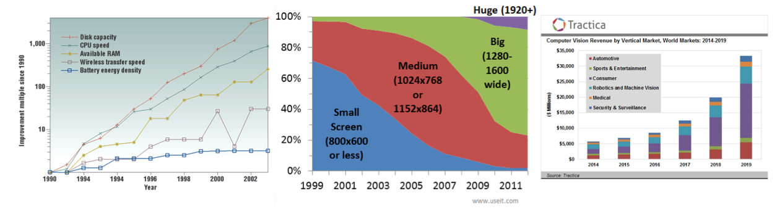
Why these three mismatches?
Improvement on battery power density does not catch up with other improvements
Improvement on common display resolution is small
Notes:
XXX futher update
You may ask why we pick the three mismatches among all potential ones
Blue curves shows the batter energy density , comparing to other imporovements such as disk capactity and CPU speed, the improvement is not in the same order of magnitude, we have mobile devices powered by battery what cannot work for a longtime

Slide 11
Why these three mismatches?
More and more image and video data are consumed by programs instead of human
Notes:
However, image analysis & computer vision techniques are applied to more and more domains

Slide 12
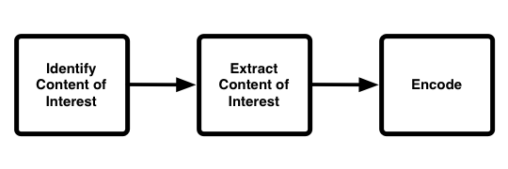
Approach
Prioritizing content of interest
Make use of hardware property
Notes:
I design good compression method that works more efficient than conventional methods in the system with mismatches that follows this approach,
Also, the design makes use of hardware property. Later I will show instances of this approach, using 3 examples.

Slide 13
Outline
1. Region of interest mismatch: microscopy video system
2. Energy mismatch: image beacon system
3. Resolution mismatch: gigapixel camera system
Notes:
I will explain the three mismatches in this order, each with an example, first, I will …

Slide 14
Outline
Region of interest mismatch: microscopy video system
2. Energy mismatch: image beacon system
3. Resolution mismatch: gigapixel camera system
Notes:
OK

Slide 15

Background: example video
Notes:
xxx may also explain the camera

Slide 16

Research question
ROI
The capture side captures the entire frame, the viewer side only uses pixels in ROI
Notes:
For this system, we have this …
Spherical lens / multiple microcamera
https://s3.amazonaws.com/aqueti.data/composites/03092014121300/03092014121300.tiles/index.html

Slide 17
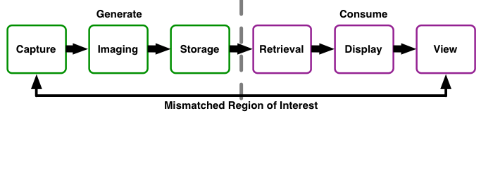
Mismatch: microscopy video
Notes:
We have a mispatched region of interest here because …

Slide 18
Hypothesis
For systems having a mismatch on the quality requirement on the region of interest. A customized compression algorithm that prioritizes the content of interest can compress the data much smaller than standard method, and the compressed data is useful for the application.
For example, a microscopy video compression technique that preserves region of interest for analysis programs can compressed the data 20x smaller than H.264, the compressed data analysis result matches the uncompressed video.
Notes:
OK

Slide 19
Related work
Method | Making use of temporal reduction | Compression ratio
JPEG | No | ~4
H.264 | Yes | ~5
Bernas et al. | No | ~9
Our method | Yes | ~100
Bernas T, Asem EK, Robinson JP, Rajwa B. 2006. Compression of fluorescence microscopy images based on the signal-to-noise estimation, Microsc. Res. Tech., 69: 1–9. doi: 10.1002/jemt.20259
Notes:
There are previous image / data compression technique out there,

Slide 20
Approach
Correlation-based
Segmentation
Average the video
background
Encode video with H.264
Notes:
This shows that our microscopy video compression is an instance of the proposed approach.

Slide 21

Approach
Store only the information in a video that analysis can use
Segmentation, correlation based method, make use of hardware
Encoding
Analysis (Quality evaluation)
Notes:
To better compress microscopy video, My Approach is to store only the information in a video that analysis can use
XXX add a frame with high correlation / low correlation pointers
With several steps,
In segmentation, make use of hardware, point spread function

Slide 22
Analysis-preserve vs. Analysis-aware
Analysis Preserve
Analysis result matches the result on original video
Analysis Aware
Analysis result on compressed video follows the distribution of original video (have a distribution because of noise)
Post-processing: adding back noise
Notes:
The method has two variations, based on the definition of a lossless microscopy video
For analysis preserve, we xxx
For analysis aware, we xxx

Slide 23
Success criteria/risk and mitigation
Success criteria: the compressed the microscopy video is smaller than the one compressed using standard method. And the video still useful for analysis.
Risk and mitigation: if the compression significantly affects the analysis result, we can switch to standard lossless compression
Notes:
How do I define the success if my approach: it should work as expected, go generate a compressed video that, the analysis will produce useful result. And it works better than standard method, H.264, because the data is smaller
What if the method does not work? Xxx

Slide 24
Planned experiments
Lossless Microscopy Video Compression Performance
1. Compare against standard compression methods
2. Evaluate my method performance under different settings
3. Evaluate my method performance with different types of microscopy video
4. Evaluate “sliding window” extension for videos with fast moving objects
Lossy Microscopy Video Compression Performance
5. Compare against standard compression methods
6. Evaluate my method performance under different settings
7. Evaluate my method performance on synthesized microscopy video
8. Evaluate my method performance on real microscopy video
Notes:
To evaluate my method, I plan to do these experiments, they include experiment for …

Slide 25
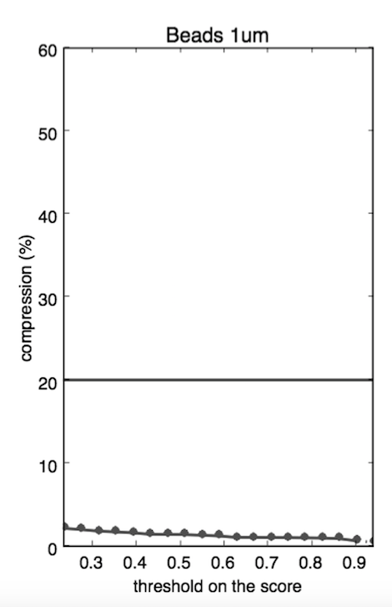
Preliminary result: compression ratio
 | Video 1 (Beads 1μm) | Video 2 (Beads 500nm) | Video 3 (Brightfield 1) | Video 4 (Brightfield 2) | Video 5 (Cells)
H.264 | 20% | 28% | 47% | 50% | 33%
Our method | 0.77% | 20% | 44% | 7.3% | 4.8%
H.264
our method
Foreground segmentation threshold
Notes:
I will show one prelimnary result…. Xxx explain the plot

Slide 26
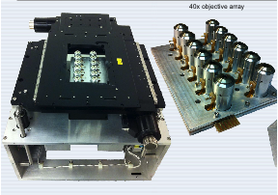
Outline
Region of interest mismatch: microscopy video system
2. Energy mismatch: image beacon system
3. Resolution mismatch: gigapixel camera system
Notes:
Now I will talk about the compression technique that for system with second type of mismatch: energy constrants, I will discuss an example, which is image beacon system

Slide 27
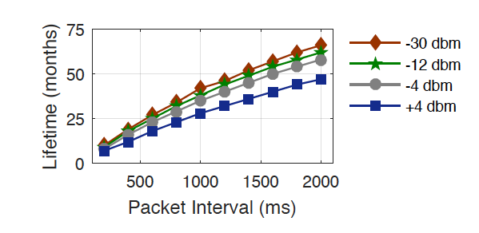

Background: Bluetooth low energy beacons for multimedia data broadcasting
Devices that broadcast small pack of data to nearby portable electronic devices.
Protocol designed to enable devices with low power consumption.
Only transmits small packets.
Long lifetime: 3~5 years
Notes:
Recently become popular,
BLE beacons are battery powered devices that broadcasts short ble data
Protocol is designed to ...
The devices using this protocol only... So that power consuption is very low
Estimote broadcasting signal for 3~5 years
many models on the market, with cheap price, each costs several dollars
Apple/google protocol based on xxx /SDK,

Slide 28

Background: usage of BLE
http://prismdevkit.com/lesson-8-an-intro-to-estimote-beacons/
Notes:
Poople uses these Ble devices in retail stores. They deploy…delivers advertisement, item information... Coupons, even used for payment
Assumes user have internet connection
Shows typical use case
System briefly knows where you are
-This technology enables applications in several domains including ….
-serie of Use cases:
Customer can get advertisements in the entrance, do automatic checkin and rewarded with coupons,
With indoor location feature, the beacon delivers to cumster the information of the products that are close to the customter,
They can even do smooth checkout withit

Slide 29
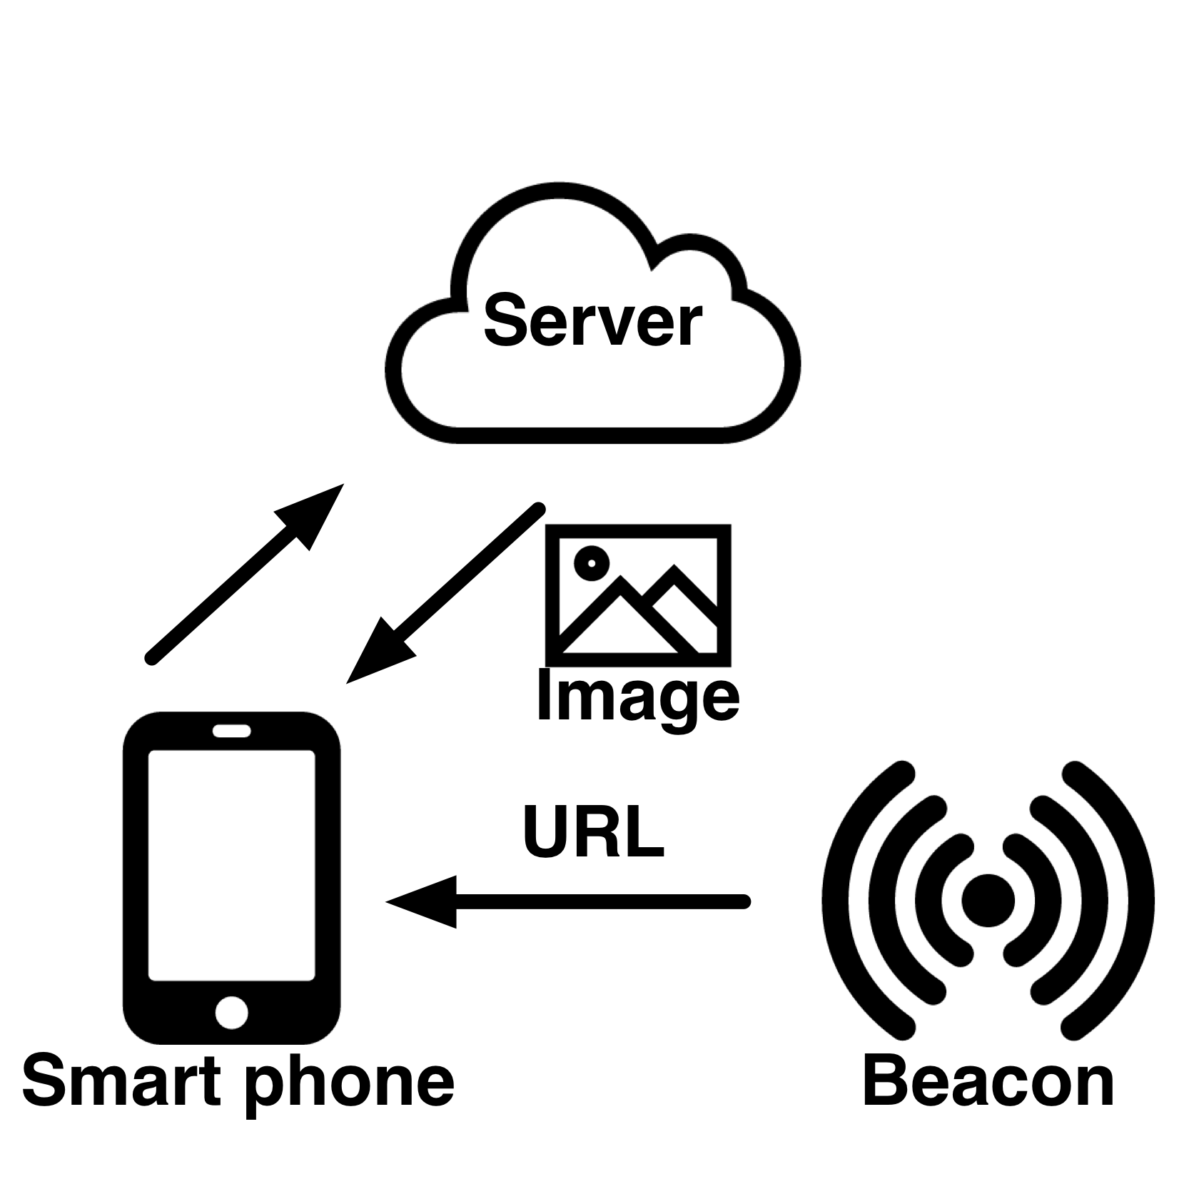
Background: usage of BLE
Notes:
This feature is covered by the previous data flow -
Data flow for images

Slide 30




Problem: what if there is no Internet connection?
http://www.sierraclub.org/sierra/activism/saving-wild-places?page=7
Notes:
The question is can you have a BLE based image storage/broadcasting systems without internet connection?
but .....
Imaging in a Wild place without internet connection, you still want to retrieve rich multimedia such as images data from beacon
This is useful because a traveller doing Hiking can write custom images presents useful information such as navigation signs into beacon
And drop the beacon
So other people come later. And it will last for years.
Surveillance camera connect to beacons taking pictures and people can use a drone can fly close to retrieve the images

Slide 31

Challenge
iBeacon packet format
Limited broadcasting data packet size
4 Bytes in iBeacon mode (UUID is not changeable via API)
18 Bytes using Eddystone URL mode
Future: BLE 5.0 with 8x broadcasting capacity: ~256 bytes
http://www.argenox.com/bluetooth-low-energy-ble-v4-0-development/library/a-ble-advertising-primer/
Notes:
Because of the energy constraint, the protpocal allows small packet size
The major challenge we face is the extremly limited storage space of BLE beacons
-Diagram iBeacon packet foramat
- With the ibeacon format and SDK, what the user can use as storage space is 4 bytes
-details: naively using the ibeacon protocol that broadcasting uuid, major and minor values, we cannot change the UUID so we only got 4 bytes each beacon
Eddystone
Deeper hack: maximum xxx bytes
A typical image with small size (64 x 64) can easily exceeds 5 thousands bytes

Slide 32




Conventional compression is not good enough
A typical simple shape 64x64 JPEG format image: 400 bytes ~ 2KB
Default quality
8549 Bytes
Quantization
level 20
1077 Bytes
Default quality
1382 Bytes
Quantization
Level 20
732 Bytes
Notes:
Put here: simple shape such as a image of disk it’s size
for a more complicated image such as Lena
The first row is all JPEG compression
JPEG is about tranferring signal into freq space and downsampling
Quantization is like downsampling in frequency space
What else is there besides JPEG? Backup slide ready for that.
Cite state of art color image compression codec
Tree-based image compression paper

Slide 33
Research question: given bandwidth/lifetime/storage constraint, use Bluetooth Low Energy beacons in a multimedia system
unlimited energy
Limited energy: battery powered,
3 ~ 5 years
Notes:
We consider the image storage and broadcast phase of the system
IN storage…
On the right side, ... The system works in low power consumption mode

Slide 34
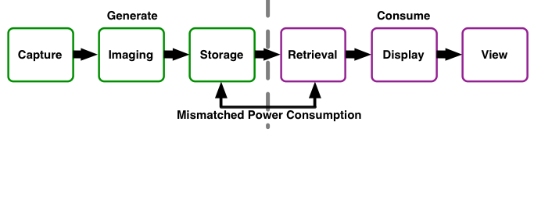
Mismatch: Bluetooth Low Energy beacons in a multimedia system
Notes:
OK
Then we have the second type of mismatch

Slide 35
Hypothesis
For a multimedia system with mismatch between energy constraints, a compression method that prioritizes the content of interest can compress the data smaller than standard method, so that the system has low energy cost and the compressed data has high quality for the application.
For example, an image beacon system can compress the data 2~8 times smaller than standard JPEG method, so the system can store and broadcast the image data with 5 years lifetime. The compressed image data has high quality for the application (SSIM=0.7).
Notes:
I propose that …
I will show that

Slide 36
Related work
Method | Binary Image | Color Image | Result small enough for BLE
Chain-coding | ✔ | ✖ | ✔
JPEG | ✔ | ✔ | ✖
Shapiro et al. | ✔ | ✔ | ✖
Lu et al. | ✔ | ✔ | ✖
Our method | ✔ | ✔ | ✔
Jerome M Shapiro. 1993. Embedded image coding using zero trees of wavelet coeffcients.IEEE Transactions on signal processing41, 12 (1993), 3445–3462
Tianyu Lu, Zisheng Le, and DYY Yun. 2000. Piecewise linear image coding using surface triangulation and geometric compression. In Data Compression Conference, 2000. Proceedings. DCC 2000. IEEE, 410–419
Notes:
This table shows the related work. Including some other image compression techniques

Slide 37
Approach
Prioritizing content of interest
Foreground, adaptive encoding
Background:
Down sample -> DCT
ROI
Notes:
The approach follows the framework
Region of interest: foregorund / background
Allocate more bits describe the foreground
Still needs to preserve the background to give some context info

Slide 38
System: make use of hardware
Notes:
Having the assumption that the user uses mobile devide to catprue the image, we ask the user to take mutliple iamages with slightly different view angle, so a disparity map can be computed. Based on that, we generate a segmentation,

Slide 39
Segmentation for prioritizing content of interest
Generating an accurate segmentation
Apply a suitable encoding method for foreground region
Notes:
OK
Single image-based, segmentaiton, such as watershed based method some times are not accurate,
Depth based method requires multiple view caputre, tends to be noisy
Combine the two results

Slide 40
Image encoding
Reduce mesh density
Reduce frequency component coefficients / quantization
Notes:
Having a separation between foreground and background, foreground and background processed separately, for background it is down scaled and encoded with DCT
For foreground, the adaptive encoding …
We would like to control the size/quality of the foreground, For DCT wavelet, reducing the frequency compoent coeffs, for triangulariztio, we can reduce mesh desity

Slide 41


Another example: augmented reality
41
Notes:
As another example of this pritorizing content of interest approach, I would like to show another project I worked on
In this project, the data is no longer images, it is a 3D object motion information,
The content of interest beging the location of key ponts, in this case, head and hands locations over time.
The systems works lke this….
Camera locate the object of intesst,, track , store,
Viewer enters the room, the keypoint rendered as virtual object in the scene,
Make use of hardware
BLE can also be used to build a augmented reality system. This is anotehr example of data reduction & making use of hardware property
The system’s function is to use camera placed in the room to record and extract the object’s motiion,
And the simplified object motion “avatar” is stored in the ble beacons,
Later a viewer can come into the room, by locating herself and retrive the motion data from beacons, it can render the virtual avatar at the same place. The viewer localization makes use of the beacon signal strength. (making use of hardware property)
WE have the prorotpyte ready

Slide 42
Success criteria/risk and mitigation
Success criteria: the data contains the critical information. the beacon can deliver the stored multimedia data within a few seconds. The system has more than 3 years lifetime.
Risk and mitigation: if the compressed data size is not small enough to fulfill the success criteria, we can apply a combination of packet rolling mechanism and extra beacons.
Notes:
For our customized compression techiques on the BLE multimedia systems
The success criteria is …

Slide 43
Planned experiments
Image Beacon System Performance
1. Compare the image compression performance with JPEG
2. Evaluate the system performance with different number of beacons
3. Evaluate the system performance with different types of input images
4. User study
Augmented Reality Beacon Performance
5. Measure the memory/running time cost for every component in the system
6. System localization peroformance
7. User study
Notes:
OK

Slide 44
Compression result
Notes:
OK

Slide 45
Outline
Region of interest mismatch: microscopy video system
2. Energy mismatch: image beacon system
3. Resolution mismatch: gigapixel camera system
Notes:
OK

Slide 46
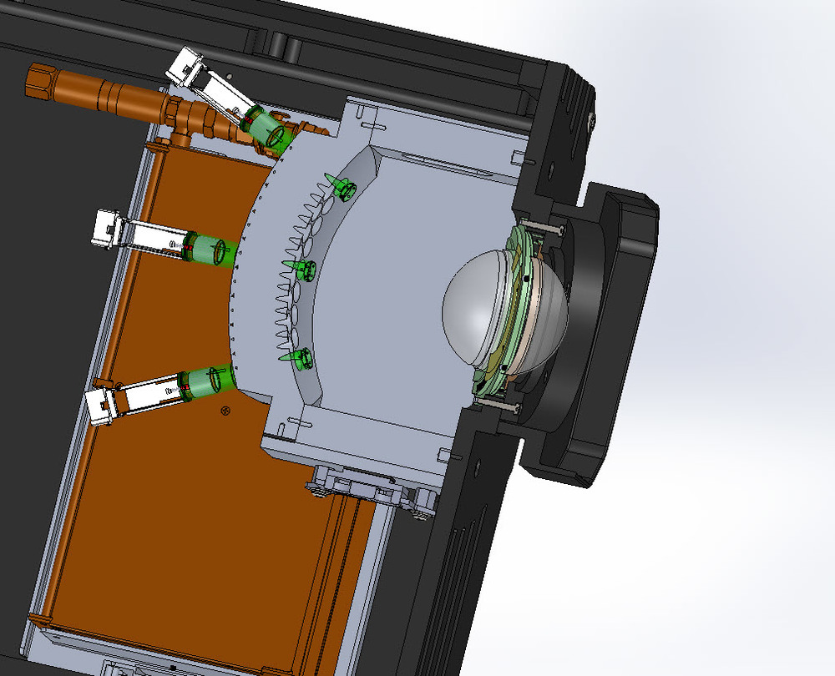
Background
Notes:
This shows a gigapixel scale camera, There is array of microcameras behind the large lens. The gigapixel frame is generated by stitihcing microcaemra frames together

Slide 47
Research question
The two sides: imaging and display have mismatched resolution
~1G pixels
2M pixels
Notes:
We can see here the imaging module has resolution in gigapixel scale, while on other side the standard display has much smaller resolution,

Slide 48
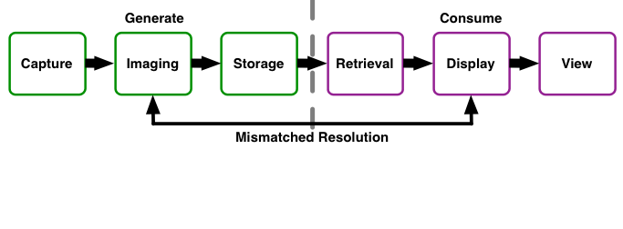
Mismatch: multi-camera video compression:
Notes:
We have a mismatch on resolution between two sides, the question is how to have a efficient data reduction mechanism in such system

Slide 49
Hypothesis
For a multimedia system with mismatch on frame resolution, a compression method that prioritizes the content of interest can more efficiently transmit the data. And the transmitted data is still useful for the application.
For example, a gigapixel camera system that divide frame into tiles can compress and transmit only required tiles to the client. By doing this the pixel overhead (# pixel transmitted minus # pixel displayed) is greatly reduced. An optimal tile size can further improve the system performance.
Notes:
I propose that for a multi media ..
As an example. I will show that a gigapixel camera system that divide frame into tiles and transmited the required tiles,can reduce the pixel overhead, and we can optimize the tile size to further improve the system perofrmance.

Slide 50
Related work
Method | Support Video? | Fixed size tile? | Optimize based on video codecs?
Kopf et al. | ✖ | ✔ | ✖
Makar et al. | ✔ | ✖ | ✖
Mavlankar et al. | ✔ | ✔ | ✖
Our method | ✔ | ✔ | ✔
Kopf, J., Uyttendaele, M., Deussen, O., & Cohen, M. F. (2007, August). Capturing and viewing gigapixel images. In aCm Transactions on Graphics (TOG) (Vol. 26, No. 3, p. 93). ACM.
Makar, M., Mavlankar, A., & Girod, B. (2009, November). Compression-aware digital pan/tilt/zoom. In Signals, Systems and Computers, 2009 Conference Record of the Forty-Third Asilomar Conference on (pp. 846-850). IEEE.
Mavlankar, A., Baccichet, P., Varodayan, D., & Girod, B. (2007, September). Optimal slice size for streaming regions of high resolution video with virtual pan/tilt/zoom functionality. In Signal Processing Conference, 2007 15th European (pp. 1275-1279). IEEE.
Notes:
People have been working on the tiling based approach for gigapixel camera systems. Some of them targets on still images only, some of them does not have a fixed tile size in the system, and none of these are fullly optimied for video codecs

Slide 51
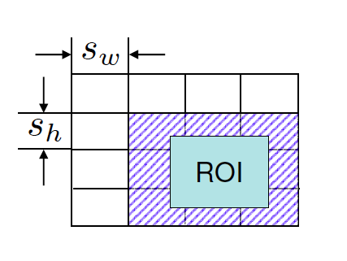
Approach
System receives information about current ROI
Extract tiles
JPEG, H.264, H.265…
Notes:
Mention that this approach has been designed and implemented, my research is to optimize it

Slide 52
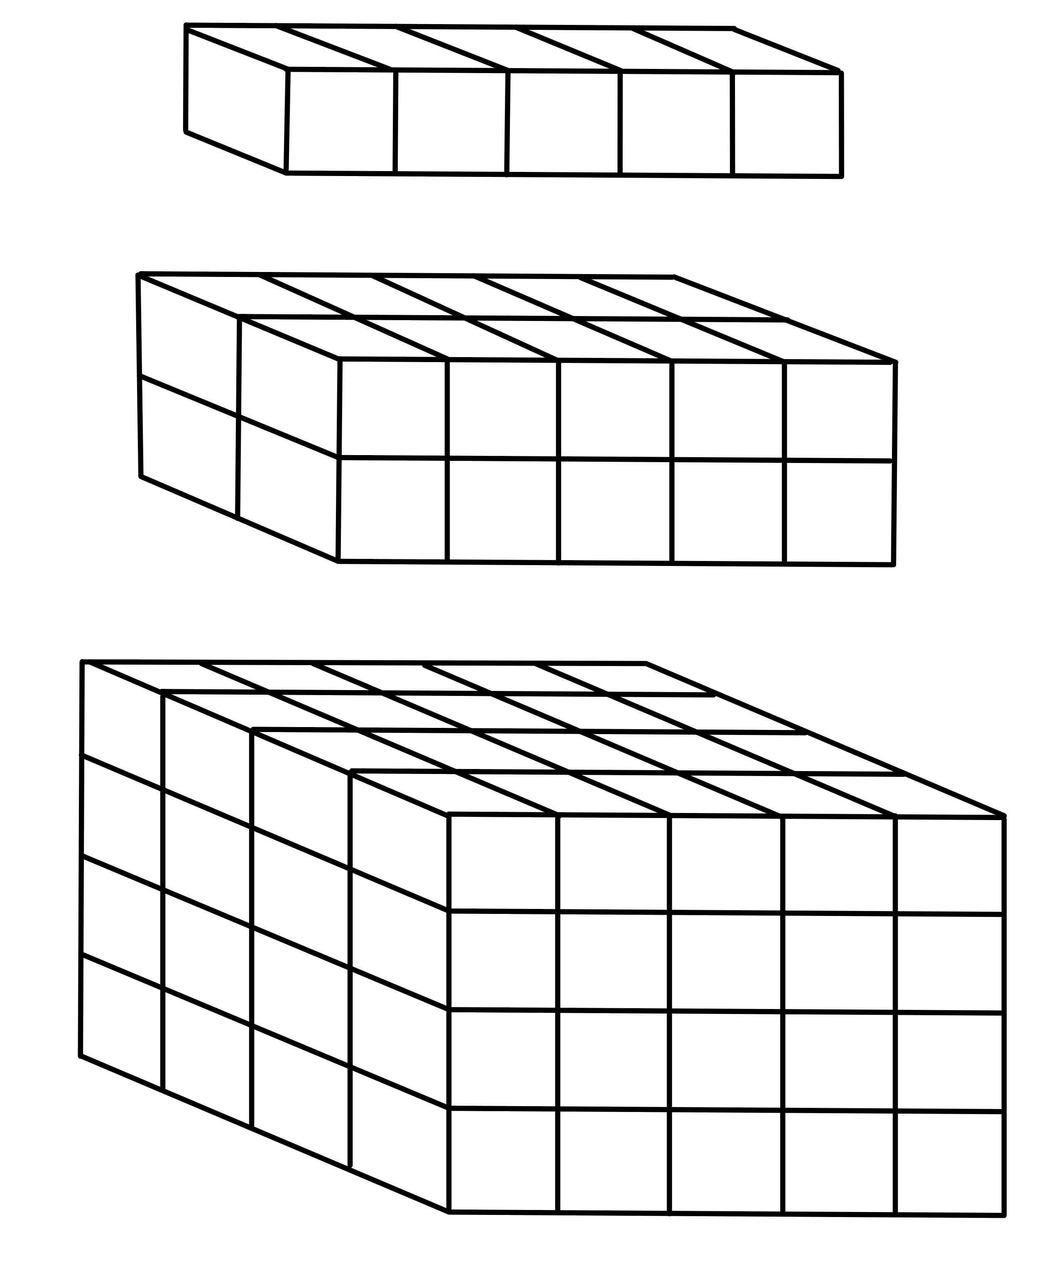
Approach
Problem statement:
Find a good time duration t for segment
Find a good size for a tile: w and h
w
t
h
52
Notes:
Cosider the lefe face as a video frame, the subblocks are the tiles dividding the frame,
If a video codec is applied, we have video frames that can be decodec by itself I frame, and vidoe frames that needs to be decoded based on other frames. (P frame), usually we have one I frame for a set of P frames, then another parameter we would like to optimize is the frequency of I frame
As a conclusion, we arrange the gigapixel video data into a set of fixed size units spatialy and temorally, we want to determine the unit size.

Slide 53
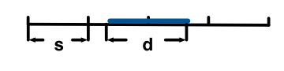
Definition
Pixel overhead: [pixel transmitted] – [pixel displayed]
Expected pixel overhead = s−1
Expected pixel overhead =
(s_{w}−1)(s_{h}−1) + d_{h}(s_{w}−1) + d_{w}(s_{h}−1)
No result on optimal temporal segment length
Notes:
Previous work have been done on some simple form of the problem.

Slide 54
Success criteria/risk and mitigation
Success criteria: an optimal tile size is found. The system achieves the best possible performance in terms of pixel overhead.
Risk and mitigation: the limitation in implementation may only allow a fixed set of tile size configurations. For this case we pick the one that is closest to the optimal setting in theory.
Notes:
OK

Slide 55
Planned experiments
1. Derive the optimal length of the tile video stream analytically, with the similar approach as the related work.
2. Verify the result with empirical study
3. Study the case when arbitrary tile size can not be achieved
4. Add the factor that the hardware will have different encoding efficiency on vairous tile sizes
5. Evaluate the system performance in terms of data processing time
Notes:
OK

Slide 56
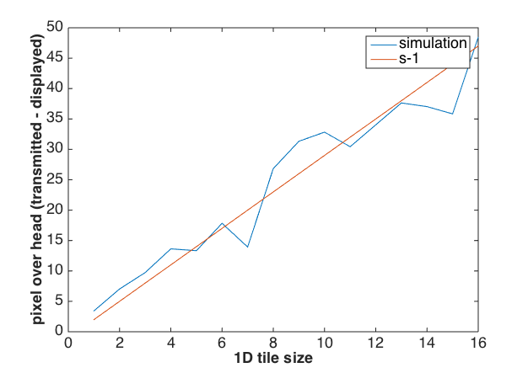
Preliminary result: simulation (1D)
Simulation helps verify the analytical result
Trivial case: 1D
Notes:
OK

Slide 57
Conclusion
I explained the data compression techniques for systems with mismatch on the quality requirement on the region of interest, the mismatch on energy constraints and the mismatch on frame resolution.
The compression techniques uses the same approach: prioritizing content of interest
Notes:
OK

Slide 58
Schedule
02/08: gigapixel camera optimal tile project: empirical study
02/08 Decide oral exam topic
02/15 prepare for oral exam
02/08 Prepare for dissertation
03/15: write paper on the optimal tile project
05/30 dissertation defense
04/01 optimal tile project paper submission
04/01 oral exam
Notes:
OK xxx how to say this

Slide 59
Papers
Published:
1. Shao, C., Zhong, A., Cribb, J., Osborne, L. D., O'Brien, E. T., Superfine, R., ... & Taylor, R. M. (2015). Analysis‐preserving video microscopy compression via correlation and mathematical morphology. Microscopy research and technique, 78(12), 1055-1061.
2. Shao, C., Nirjon, S., & Frahm, J. M. (2016, May). Years-Long Binary Image Broadcast using Bluetooth Low Energy Beacons. In Distributed Computing in Sensor Systems (DCOSS), 2016 International Conference on (pp. 225-232). IEEE.
3. Shao, C., & Nirjon, S. (2017) ImageBeacon: Broadcasting Color Images over Connectionless Bluetooth LE Packets. In Proc. of 2nd IEEE International Conference on Internet-of-Things Design and Implementation (IoTDI 2017), 12 pg,
Under Submission/In Preparation:
4. Shao, C., Cribb, J., Osborne, L. D., O'Brien, E. T., Superfine, R., ... & Taylor, R. M. Analysis‐aware video microscopy compression, Microscopy research and technique
5. Shao, C., Islam, B., & Nirjon, S. MARBLE: Mobile Augmented Reality Using BLE Beacons
6. Shao, C. et al, Optimal Temporal Slice Size for Streaming Regions of High Resolution Video
Other work as coauthor:
7. Cribb, J.A., Osborne, L.D., Beicker, K., Psioda, M., Chen, J., O’Brien, E.T., Taylor II, R.M., Vicci, L., Hsiao, J.P.L., Shao, C. and Falvo, M., 2016. An automated high-throughput array microscope for cancer cell mechanics. Scientific reports, 6.
([1, 4, 7]: region of interest mismatch; [2, 3, 5]: energy constraint mismatch; [6]: resolution mismatch)
Notes:
OK

Slide 60
Questions
Notes:
OK

Slide 61
